Slide 1



Functional Roles of Migratory Waterbirds
Josh Nightingale
Universidade Federale do Rio Grande do Sul
& Erasmus Mundus
International Master in Applied Ecology

Slide 2
Questions
Functional roles of migratory vs resident species?

Slide 3
Questions
Functional roles of migratory vs resident species?
Less constrained by breeding habitat

Slide 4
Questions
Functional roles of migratory vs resident species?
Less constrained by breeding habitat
Constrained by necessity of migration!

Slide 5
Questions
Functional roles of migratory vs resident species?
Functional equivalence of summer and winter migrants?

Slide 6
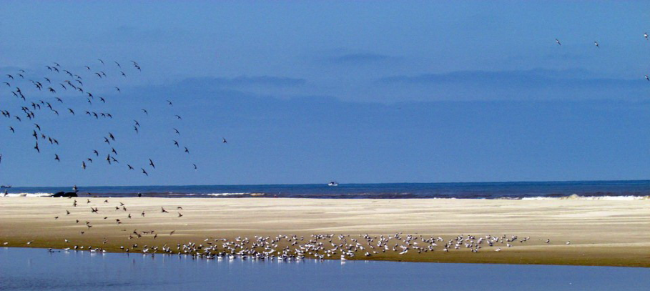
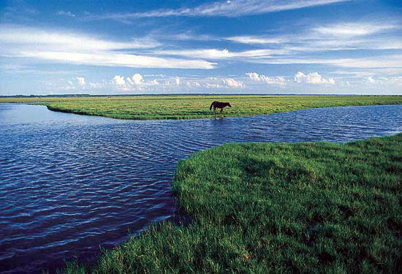
Questions
Functional roles of migratory vs resident species?
Functional equivalence of summer and winter migrants?
Differences between habitats in functions supported?

Slide 7
Questions
Functional roles of migratory vs resident species?
Functional equivalence of summer and winter migrants?
Differences between habitats in functions supported?
Anything else…?

Slide 8

Data: censuses
Monitoring data
Single count per site
Summer or winter
Various habitats
Lake, beach, grassland
Incomplete coverage
At least once each in summer and winter

Slide 9
Data: traits
Migration
Morphology
Diet
Behaviour

Slide 10
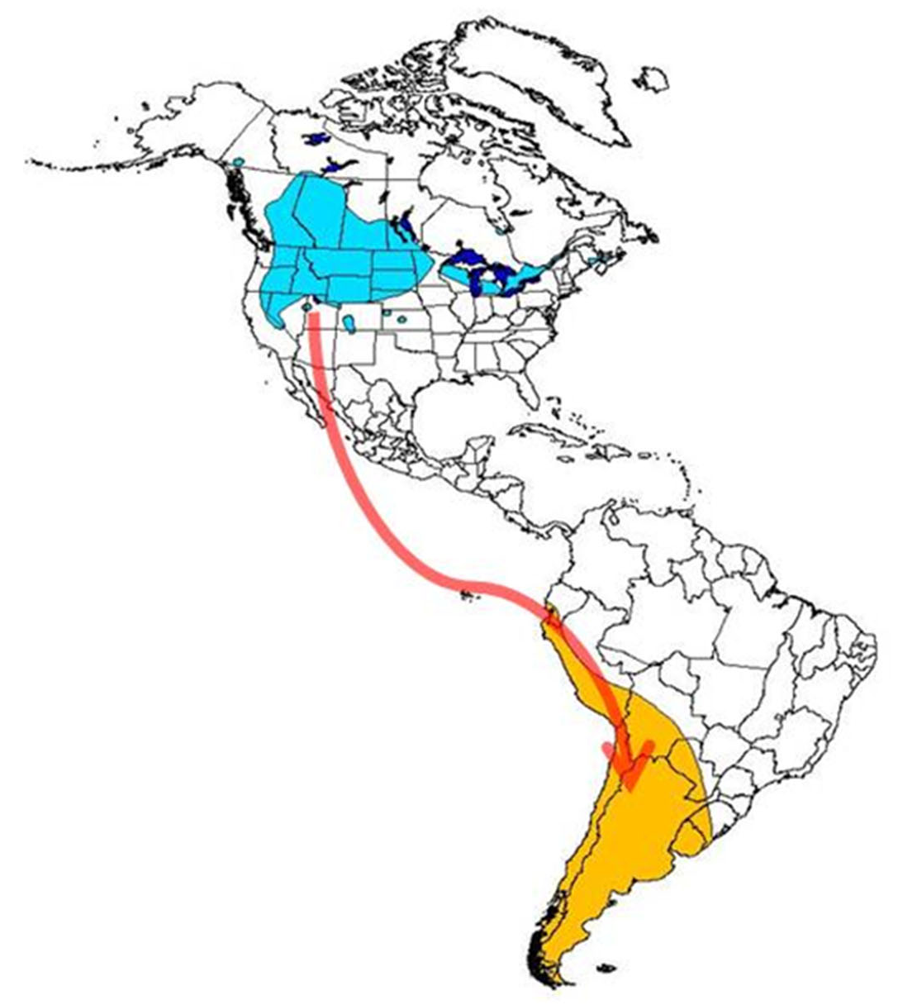
Data: traits
Migration
Summer,
winter or
resident?

Slide 11

Data: traits
Migration
Morphology
Mass

Slide 12

Data: traits
Migration
Morphology
Mass
Tarsus length

Slide 13

Data: traits
Migration
Morphology
Mass
Tarsus length
Bill length

Slide 14
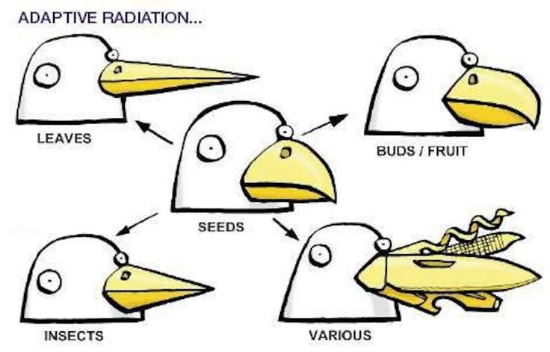
Data: traits
Migration
Morphology
Mass
Tarsus length
Bill length
Bill shape

Slide 15






Data: traits
Migration
Morphology
Diet

Slide 16
Data: traits
Migration
Morphology
Diet
Behaviour
Sight vs tactile foraging?

Slide 17




Data: traits
Migration
Morphology
Diet
Behaviour
Sight vs tactile foraging?
Pecking, stabbing, hammering, sweeping etc……..

Slide 18
Analytical approach (provisional)
Functional roles
Do summer and winter migrants occupy similar areas of niche space?
Is this area distinct?

Slide 19
Analytical approach (provisional)
Functional roles
Do summer and winter migrants occupy similar areas of niche space?
Is this area distinct?
Are they more similar to each other than expected by chance?
(null model?)

Slide 20
Analytical approach (provisional)
Functional roles
Do summer and winter migrants occupy similar areas of niche space?
Is this area distinct?
Are they more similar to each other than expected by chance?
(null model?)
Why are they not resident?

Slide 21
Analytical approach (provisional)
Functional roles
Do summer and winter migrants occupy similar areas of niche space?
Is this area distinct?
Are they more similar to each other than expected by chance?
(null model?)
Why are they not resident?
Dimension reduction? (e.g. PCA)
Dendogram branch length? (distance matrix)

Slide 22
Analytical approach (provisional)
Functional equivalence
Niche space (from analysis above)

Slide 23
Analytical approach (provisional)
Functional equivalence
Niche space (from analysis above)
Hierarchical clustering of censuses
Species and trait data

Slide 24
Analytical approach (provisional)
Functional equivalence
Niche space (from analysis above)
Hierarchical clustering of censuses
Species and trait data
Species data cluster within seasons, then habitats
Contribution of migratory species

Slide 25
Analytical approach (provisional)
Functional equivalence
Niche space (from analysis above)
Hierarchical clustering of censuses
Species and trait data
Species data cluster within seasons, then habitats
Contribution of migratory species
Functional data cluster within habitats – plus seasonal role?
Ecological filtering

Slide 26
Other issues
Phylogenetic correction?
Migratory species from limited subset of lineages
Some diversified in North, others locally

Slide 27
Other issues
Phylogenetic correction?
Migratory species from limited subset of lineages
Some diversified in North, others locally
Questions applied to management?
Census data from single counts at single sites
Is it sufficient?

